Slide 1
Concentration and Focus
VEV 741 Session 4 – Goal Setting and Continuous Improvement

Slide 2
Sessions 3 and 4
Understanding your potential and the mental barriers that limit you
Understanding your personality type
Identifying a long term goal
Continuous Improvement – Kaizen

Slide 3

Let go of things that harm you

Slide 4

Validate your fears – is it real?

Slide 5
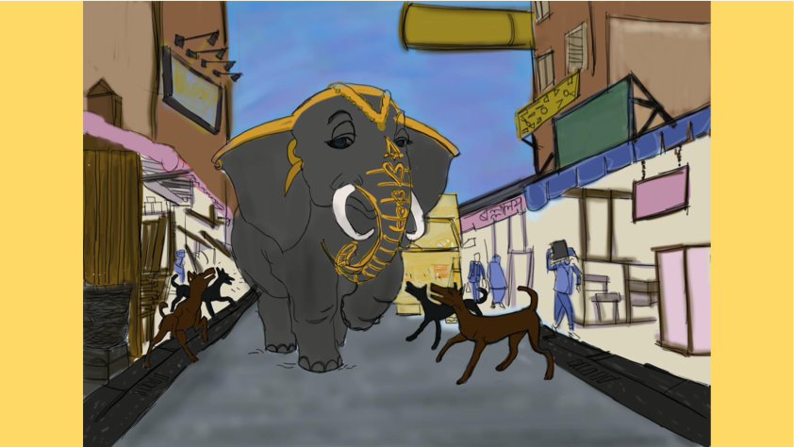
Learn to handle criticism

Slide 6



Don’t let your greed enslave you

Slide 7
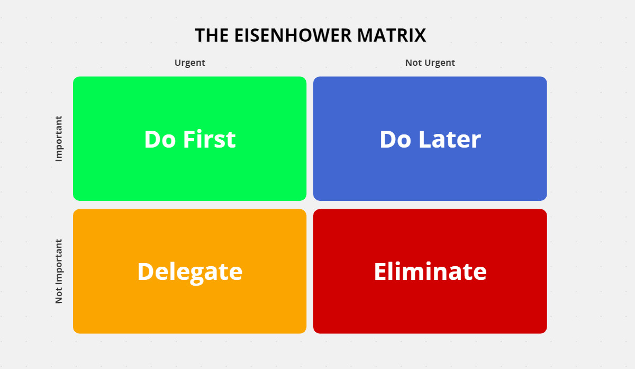
Know your priorities

Slide 8
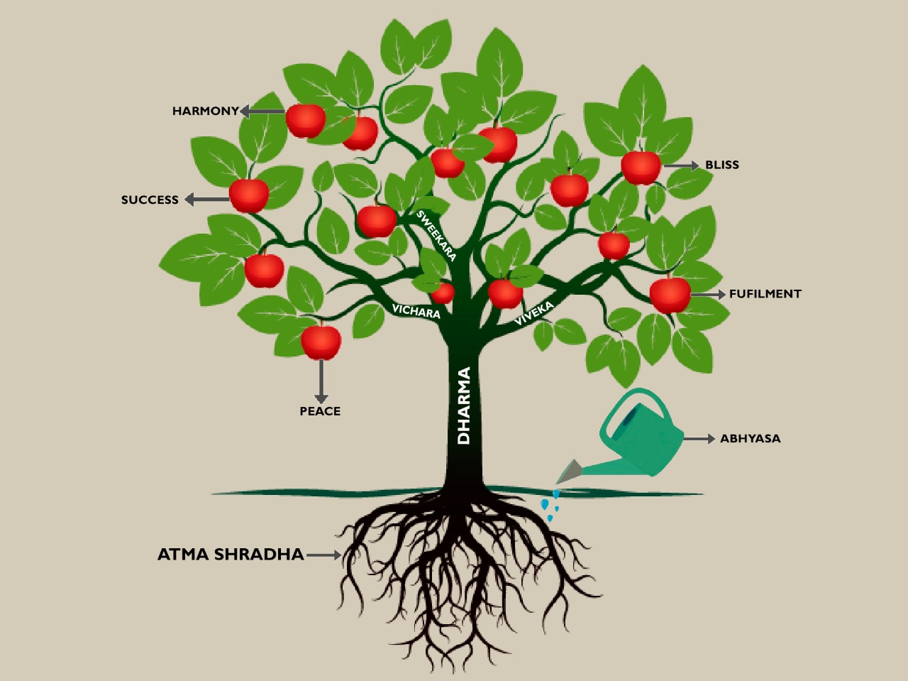
What to focus on

Slide 9
Group work
SMART
Define the goal in specific terms
Identify measures to check whether you are on track
Are your goals achievable?
How relevant is this goal to your life?
How can your ensure it is time-bound?
How do you see yourself 5 years from now?
Successful career in a company ?
Starting something of your own ?
Settling down abroad?
Higher studies?
Fitter and more healthy?

Slide 10
Group 1 – Financially secure
Sarfaraz
Mohit
Sushank
Bhavesh
Rishav
Harsh
Anjaleena
Mohit

Slide 11
Group 2 – Start something on my own
Trishani
Ethesham

Slide 12
Group 3 Settle abroad
Adika
Yateek

Slide 13
Group 4 Get fit physically, mentally, emotionally
Ajey
Abhinav
Shubha
Sparsh
Sachin
Kunal
Kulveer
Abhishek Mina

Slide 14
Group 5 - Find my purpose
Kritika
Mahdev
Jasvinder
Kushagr
Lalit

Slide 15
Others
Dheeraj Soni

Slide 16
Kaizen – Continuous improvement
1 % better consistently every day for a year = 37.78 times better – the compounding effect
Negative compounding – negative thoughts, anger, stress, blaming
Positive Compounding – knowledge, productivity, relationships
Walk slowly but never backward
Stonecutter takes a long time hammering at a rock – nothing seems to happen – till suddenly one blow shatters the rock

Slide 17
Once you decide on the goal – focus on the systems /processes – not the results
If we focus on results, once we achieve it, we get complacent
The purpose of setting goals is to win the race. The purpose of building systems is to continue playing the game with greater expertise.
“Whenever failure comes, if we analyse it critically, in ninety-nine per cent of cases we shall find
that it was because we did not pay attention to the means. Proper attention to the finishing,
strengthening, of the means is what we need. With the means all right, the end must come.
We forget that it is the cause that produces the effect; the effect cannot come by itself; and
unless the causes are exact, proper, and powerful, the effect will not be produced.”
Swami Vivekananda

Slide 18
In order to complete your one credit
You should have submitted your first assignment by now (20 %)
You should answer queries that I will put to you on Mataji’s videos by September 15 (this will count towards classroom participation)
You should have given meaningful feedback (this will count towards classroom participation )
You should identify 1 long term goal and work out your strategy to achieve it (30%) – last date October 1
Please note : Classroom participation – 50 %

Slide 19
To contact me
anu.vfaculty@iitd.ac.in
WhatsApp 9811164667

